Slide 1




The Wonderful World of .NET Cross-Platform Development
Steve Bilogan

Slide 2
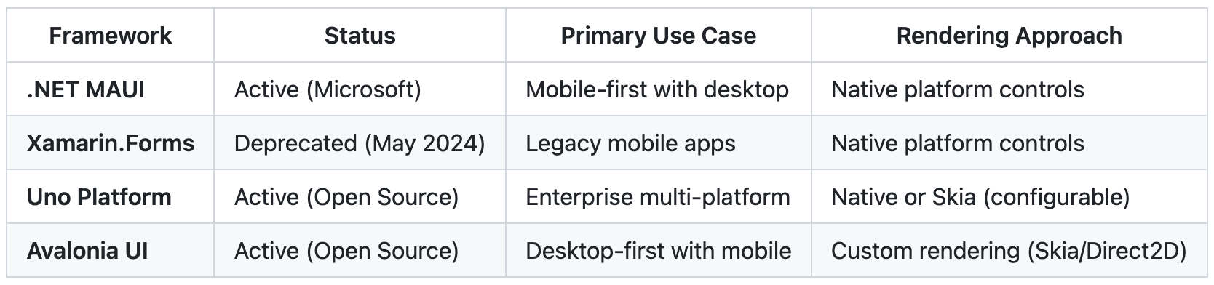
Frameworks (At a Glance)

Slide 3
.NET MAUI Report Card
Official evolution of Xamarin.Forms (Deprecated May 2024)
Native UI Rendering (through Handlers)
Unified project system (single .csproj)
XAML for UI definition
Support for iOS, Android, Windows (WinUI 3), macOS (Mac Catalyst), Tizen (via Samsung)

Slide 4
Uno PlatformReport Card
Officially announced and open-sourced in May 2018
Native and Skia-based rendering engines (customizable)
Unified project system (single .csproj, sdk-style project)
XAML/C# for UI definition
Official support for iOS, Android, Windows, macOS, Linux, WebAssembly,
Targets single-target desktop via skia backend.
Maintains support for native Windows WinUI 3 Desktop apps as well

Slide 5
AvaloniaReport Card
Open-source project started in 2013, company founded in 2019
Skia-/Direct2D-based rendering engine (in flux: The Future of Avalonia's Rendering - Avalonia UI)
Separate .csproj per platform
XAML for UI definition (.axaml)
Official support for iOS, Android, Windows, macOS, Linux, WebAssembly,

Slide 6
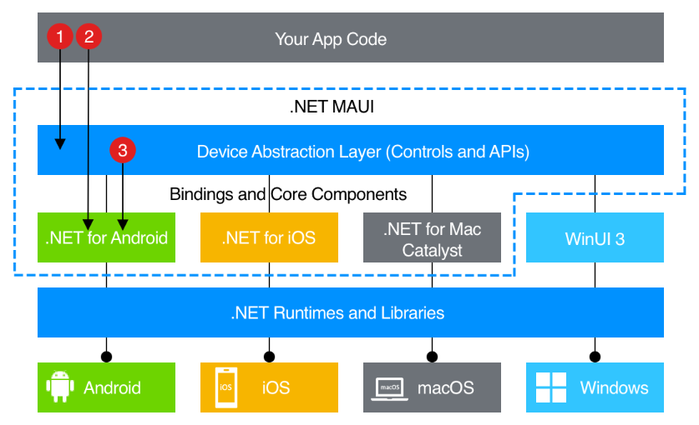
.NET MAUI Architecture
You write code that primarily interacts with the .NET MAUI controls and API layer (1). This layer then directly consumes the native platform APIs (3). In addition, app code may directly exercise platform APIs (2), if required.

Slide 7
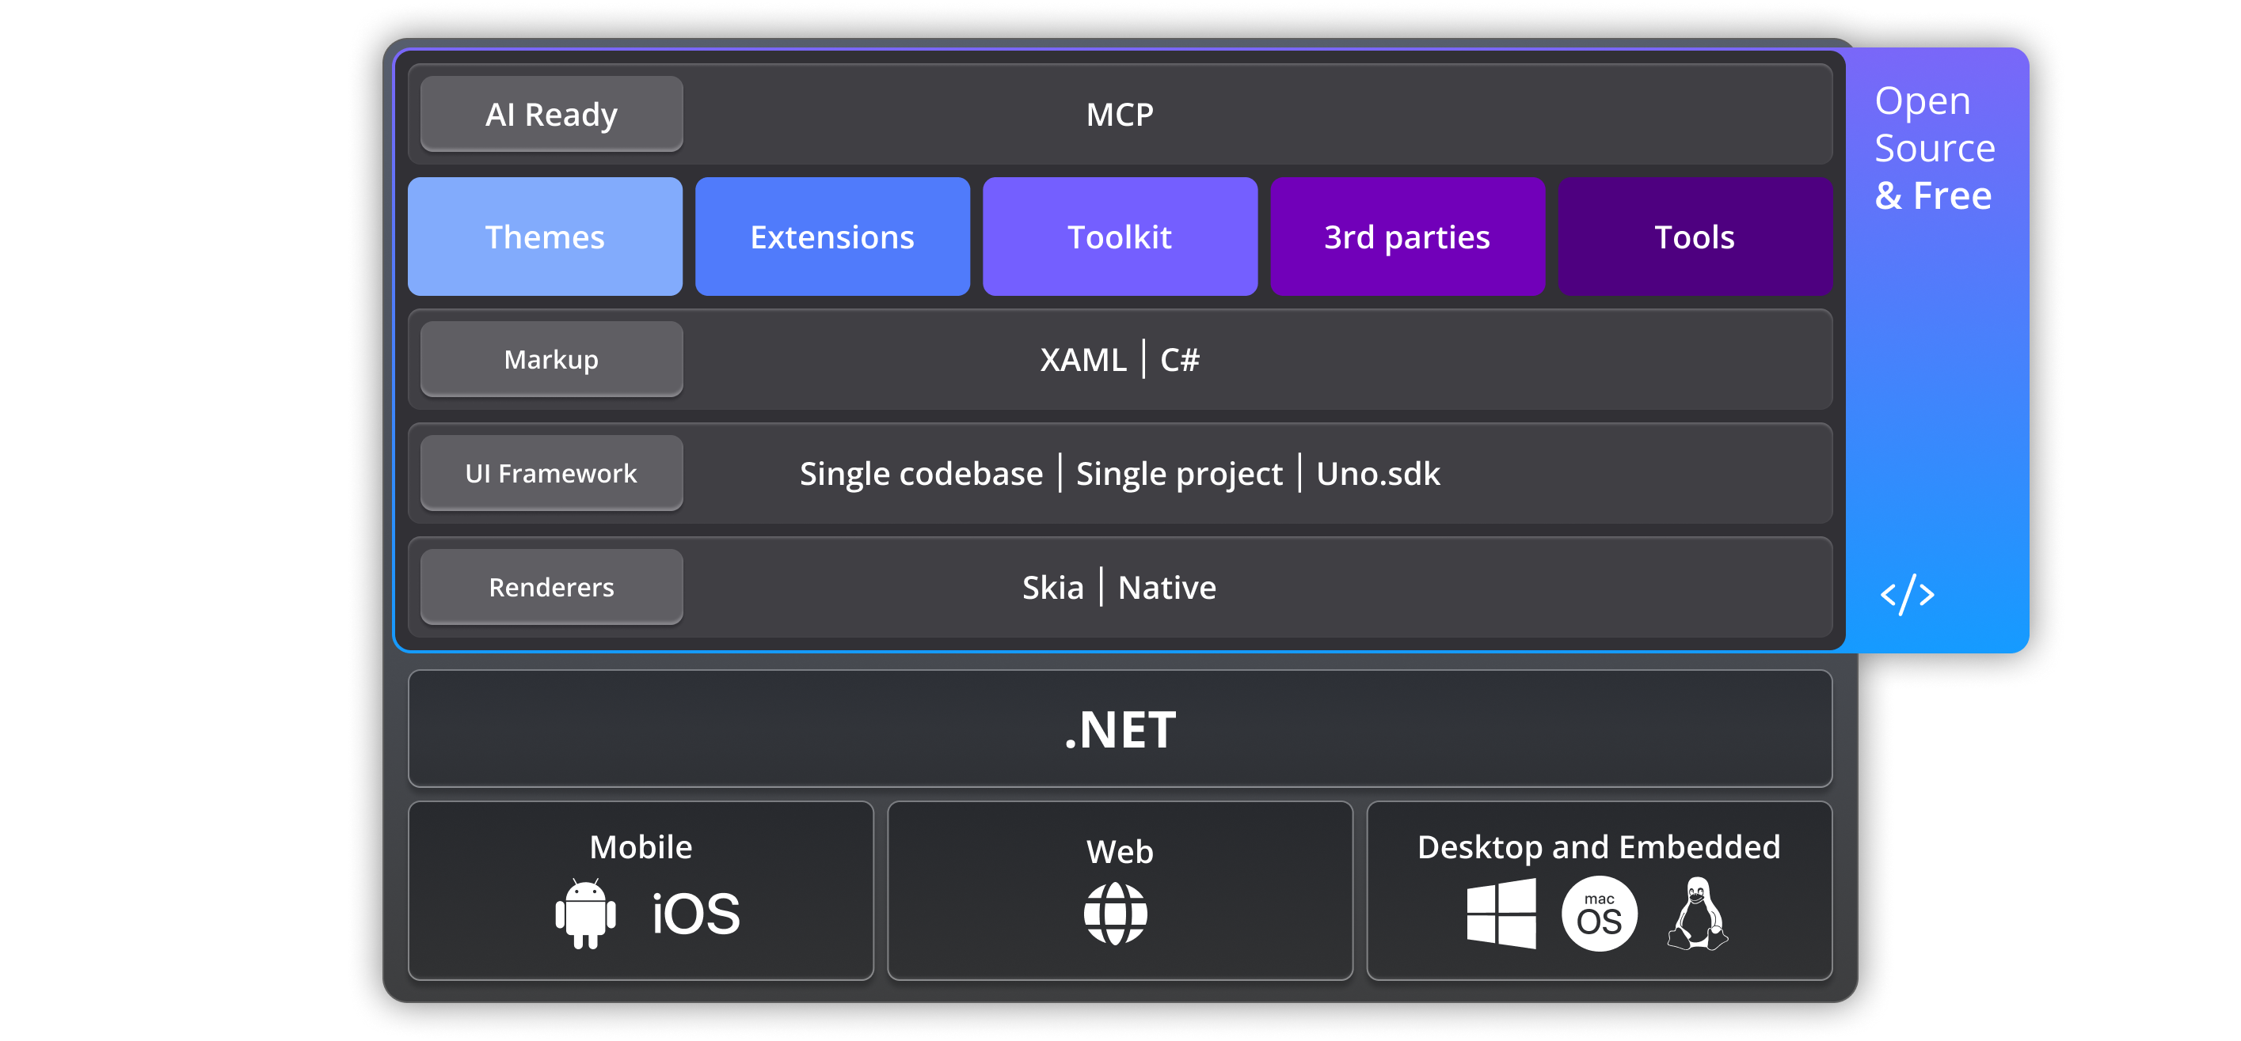
Uno Platform Architecture

Slide 8
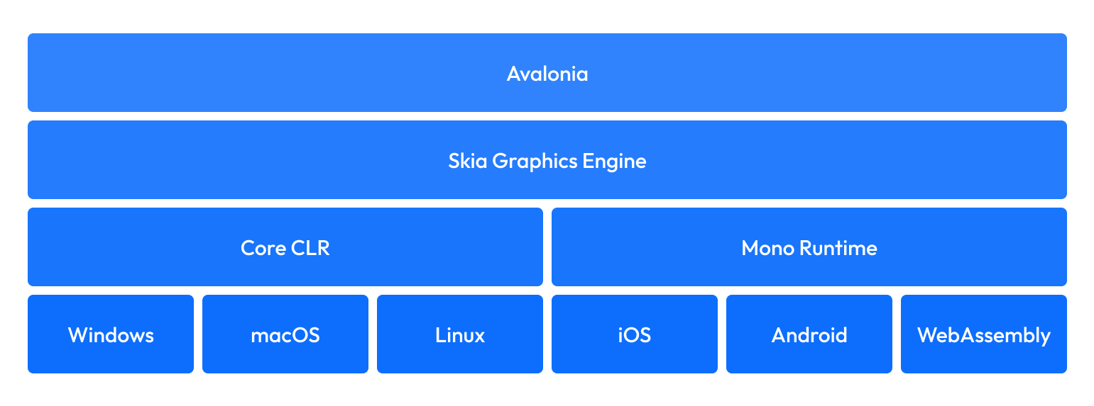
Avalonia Architecture

Slide 9
XAML Flavors
.NET MAUI (Uses its own API – evolved from XF APIs)
xmlns="http://schemas.microsoft.com/dotnet/2021/maui"
Get started with .NET MAUI XAML - .NET MAUI | Microsoft Learn
Uno Platform (Uses existing WinUI 3 APIs)
xmlns="http://schemas.microsoft.com/winfx/2006/xaml/presentation" (same as WinUI)
Differences between Uno.UI and WinUI
Avalonia (WPF-esque)
xmlns="https://github.com/avaloniaui"
From WPF to Avalonia: A Guide for .NET Developers Exploring Cross-Platform UI Frameworks - Avalonia UI

Slide 10
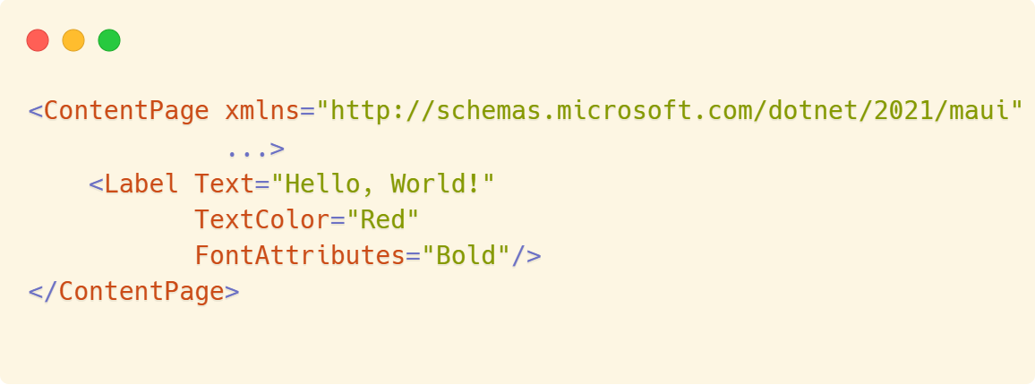
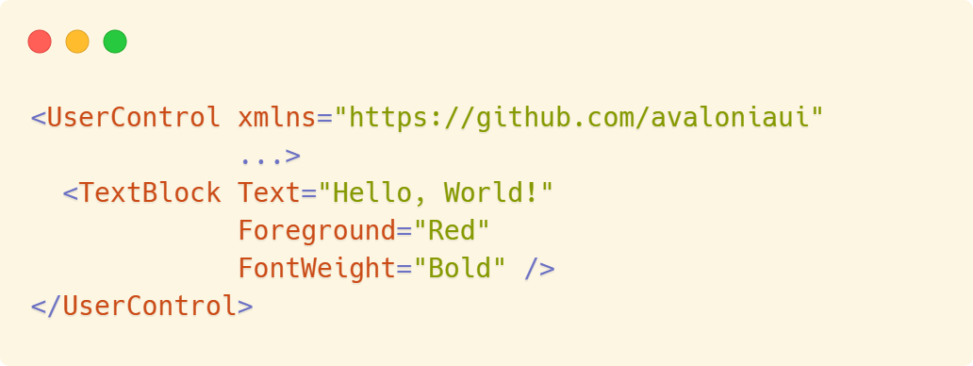
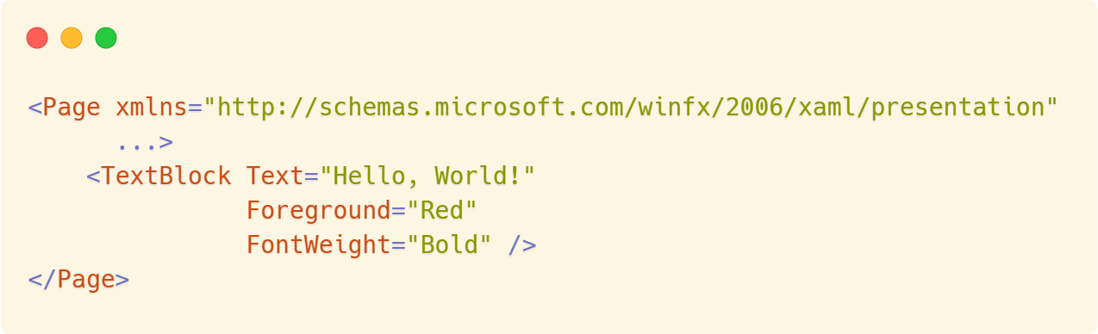
.NET MAUI
Avalonia
Uno Platform

Slide 11

Time for Demos!
See you in

Slide 12
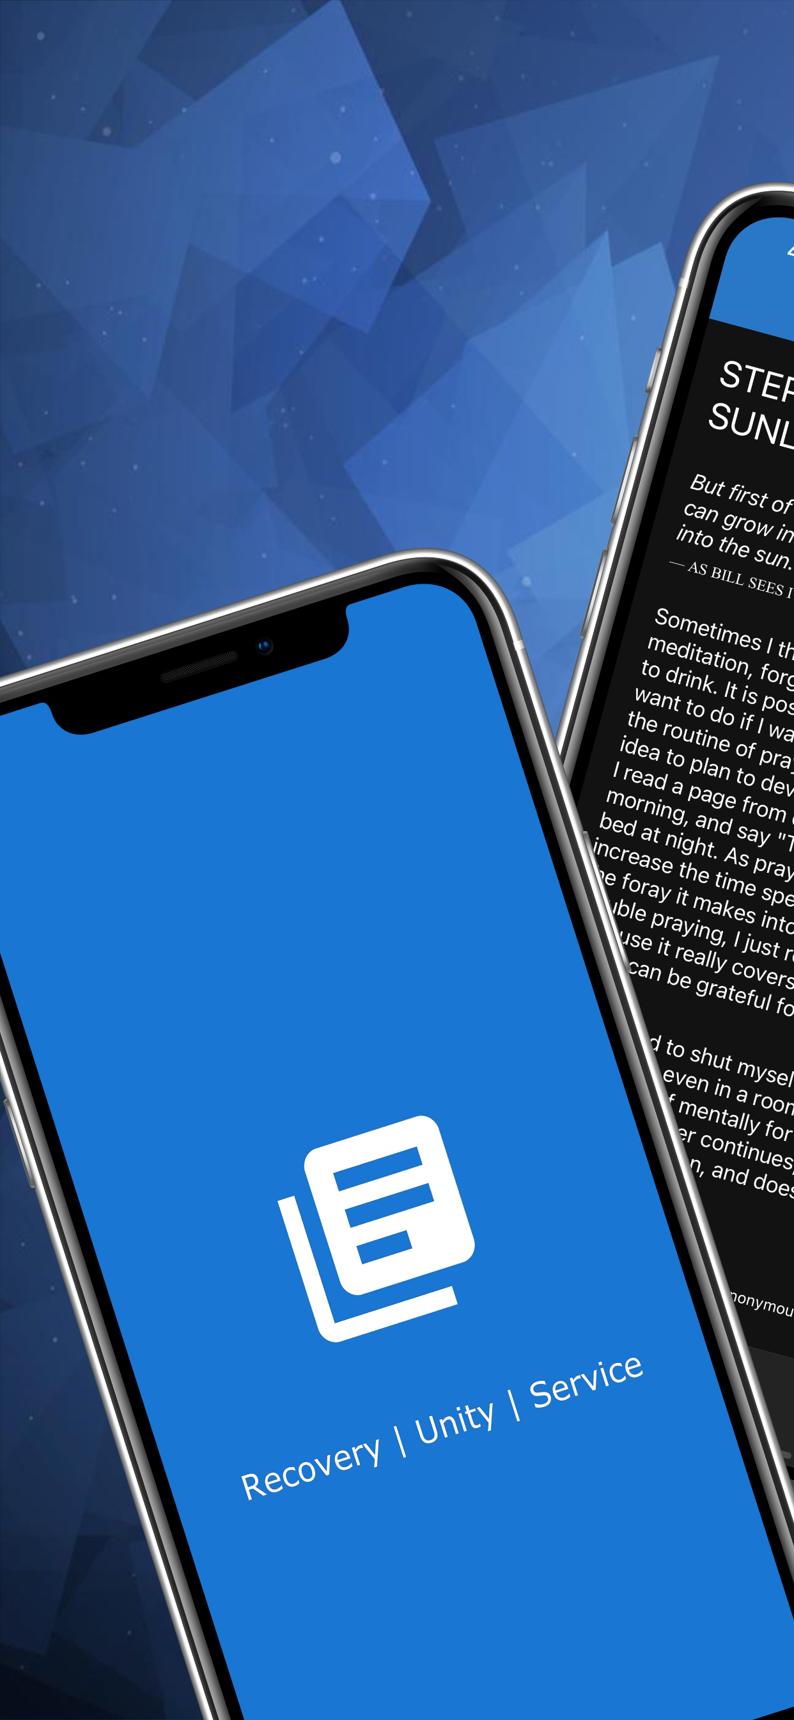
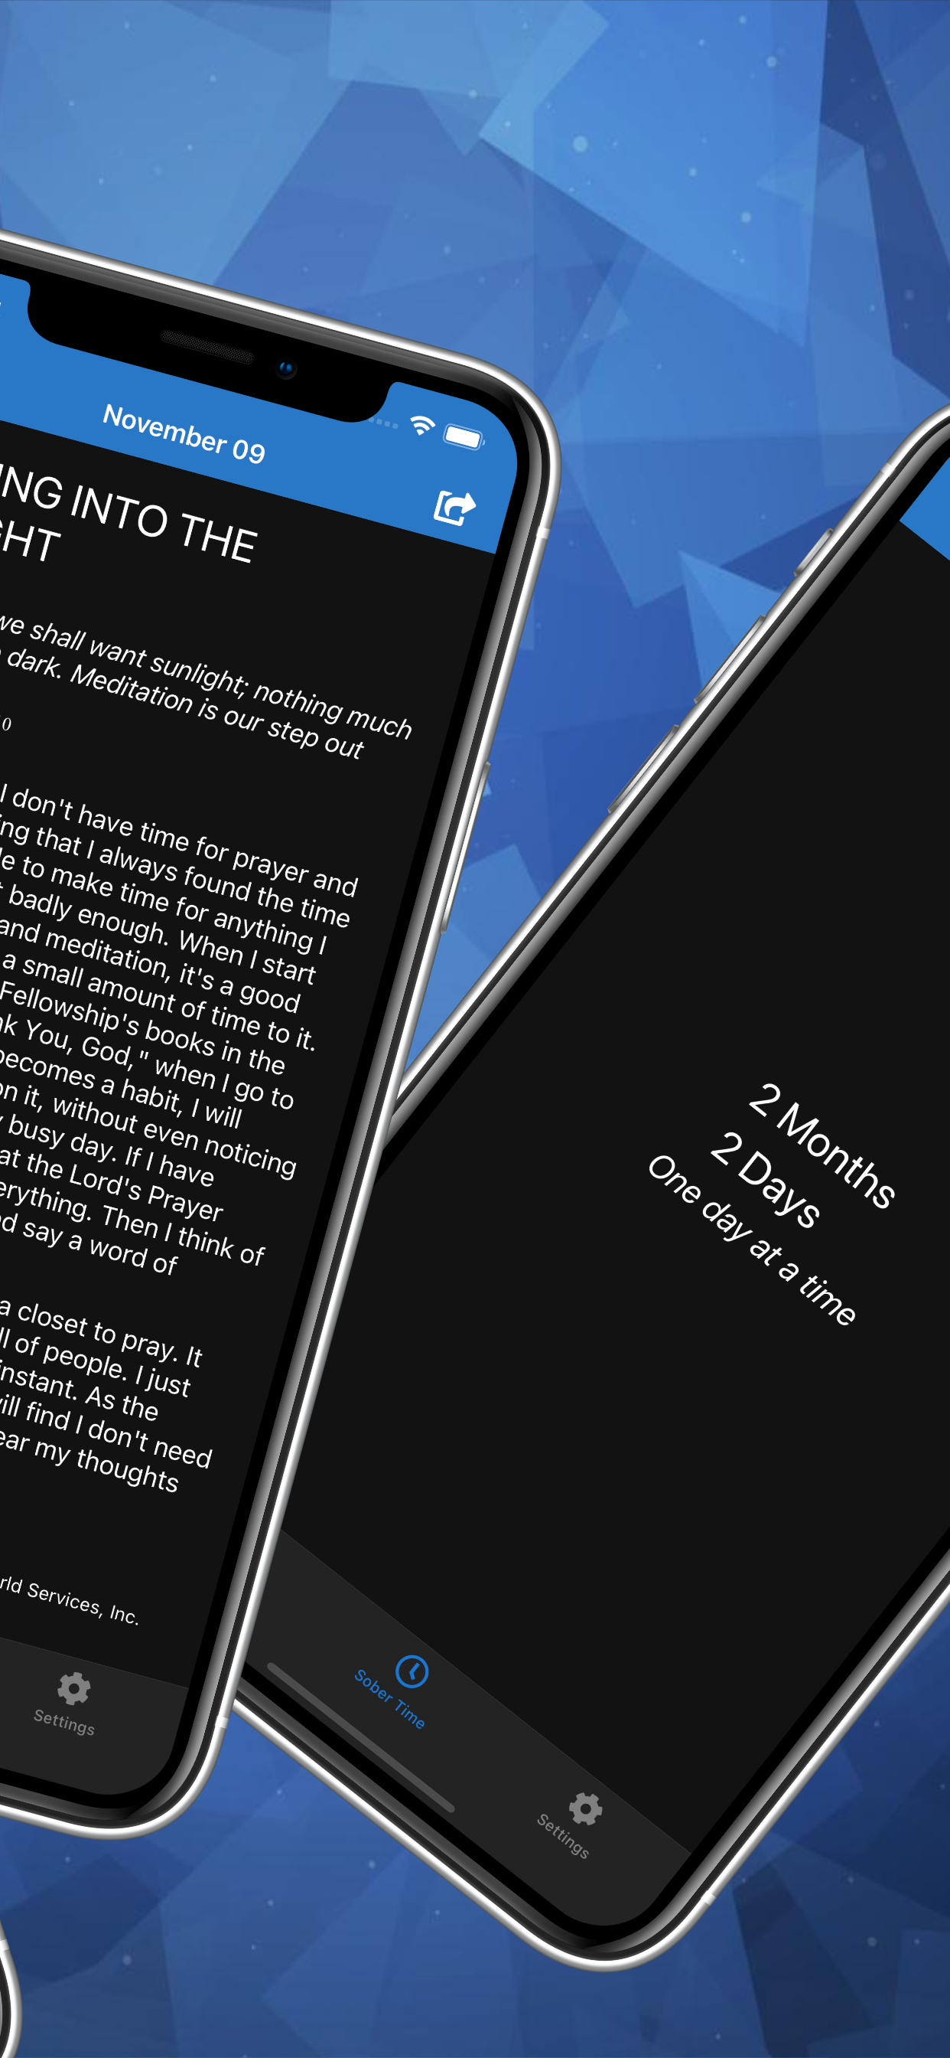
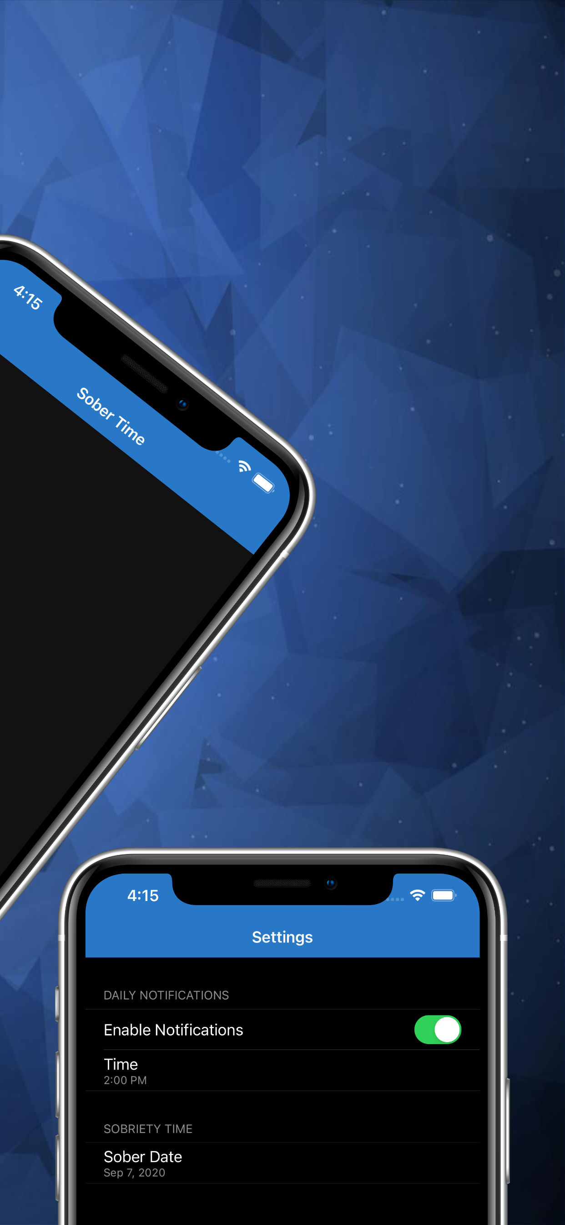
A Migration Story…

Slide 13
A Migration Story (cont.)
Xamarin.Forms app
Built and released in Oct 2020 for Android and iOS
Daily readings loaded from a sqlite db
Native local notification support for daily reminders
Xamarin.Essentials for xplat Preferences, Share APIs
Automated UI Tests (Xamarin.UITest)
https://github.com/kazo0/DailyReflection

Slide 14
A Migration Story (cont.)
Initial port to MAUI: https://github.com/kazo0/DailyReflection-ports/tree/main/DailyReflection
Refactoring Presentation and Service layers to be UI Framework agnostic
Followed up with initial ports to:
Uno: https://github.com/kazo0/DailyReflection-ports/tree/main/DailyReflection.Uno
Avalonia: https://github.com/kazo0/DailyReflection-ports/tree/main/DailyReflection.Avalonia

